Slide 1

Investment Modes for 1000 MW Floating Solar Power Plant -JREDA

Slide 2
State Solar Policy (1/2)
Jharkhand Solar Policy 2022
The State intends to contribute to India’s clean energy ambitions by deploying a cumulative capacity of 4000 MW in the state by 2027.
The nodal agency, JREDA, will therefore engage in support and coordination as per the provisions of the Policy.
VISION
KEY OBJECTIVES
Contribute to India’s clean energy ambitions by bringing energy transition closer to communities, businesses and industries
Enable ‘ease of doing’ business
Promote efficient technologies
Creating enabling infrastructure
Meet various sustainable development goals
Increase the share of solar electricity in State’s power purchase portfolio and subsequently help DISCOMs meet its RPO trajectory.
Provide investment avenues for private players and all electricity consumers to collaborate with the Government to invest in RE projects.
Provide last-mile connectivity to rural consumers in remote areas, who are off-grid.
Scale energy storage in the state by identifying viable use cases, providing financing options, and promoting research and development activities.
Support domestic manufacturing of solar PV technologies, its components such as energy storage and related ancillaries.
Create more investment and employment opportunities in the state to bring in the overall development of the state and its people.
Project Categories | Cumulative Target (in MW)
Utility-scale solar | 3,000
Solar parks | 700
Non- Solar Parks | 1,000
Floating Solar | 900
Canal Tops | 400
Distributed Solar | 720
Off-Grid Solar Projects | 280

Slide 3
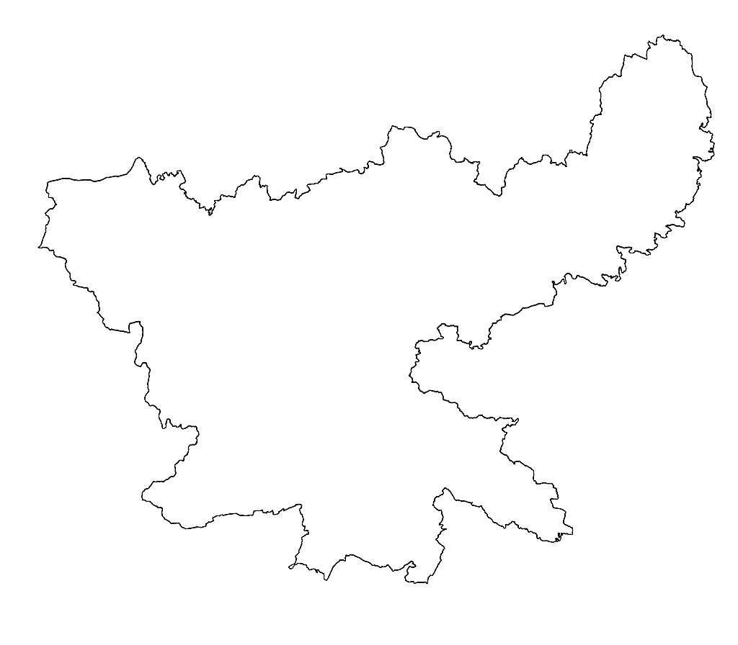


State Solar Policy (2/2)
Jharkhand
Under the total target of 4000 MW, a total target of 900 MW Floating Solar has been fixed under the Jharkhand Solar Policy 2022.
JREDA has identified, a potential of 1,000 MW floating solar from two sites namely, Tenughat Reservoir (600MW) and Chandil Dam (400 MW) to be implemented at an estimated cost of *Rs. 5,000 Cr, and is exploring to uptake this project under the following three business models:
01
Tenughat Reservoir, Bokaro
LOAN | 70 percent i.e., Rs. 3,500 crore as loan on the guarantee of the state government from a multilateral development bank
EQUITY | 30 percent i.e., Rs. 1,500 crore is proposed to be borne by the state government of Jharkhand
Total Reservoir Area: 16007 acres
Avg. Water Level: 64.87 m
Algae Growth: Less
Grid Connectivity: Yes
+
02
PPP Mode | Total 1,000 MW capacity can be approved on PPP mode, under which the plant will be installed by private investors at private cost
03
Chandil Dam, Jamshedpur
PPP Mode | Out of the estimated amount is Rs 5,000 crore, 50 percent of the capacity to be done on PPP mode
LOAN + EQUITY | Remaining 50 percent divided as 70 percent loan and remaining 30 percent as equity
Total Reservoir Area: 43018 acres
Avg. Water Level: 58.6 m
Algae Growth: Less
Grid Connectivity: Yes
* Per MW project cost considered at Rs. 5 Cr

Slide 4
Competitive Bidding/Plug & Play Model/OPEX (1/4)
Business Model: Case 1 & Case 2
Step 1: JREDA Floats RfP for selection of developers to develop 1000 MW Floating Solar Projects, generate & supply power
JREDA
Key Highlights
Case:1
JREDA will be the nodal agency.
JREDA in capacity of State aggregator of renewable energy will issue RfP.
GoJ to lease its water reservoirs/dams.
Floating Solar Projects will be set up on BOOT basis by the developer.
GoJ will pay via JREDA to the developer w.r.t the units generated and as per the rate within the PPA.
GOJ will earn from the sale of power to various DISCOMs as per the rate within the PSA.
GoJ may earn in from of the lease rent or can get rebate in the per unit power purchase cost from the developer.
Step 3: JREDA Signs PSA & Supplies Power to DISCOM’s/States at mutual agreed rates
Private Developer / SPD
Step 2: SPD signs PPA & Supplies Power to JREDA at rate discovered under competitive bidding reverse auction
DISCOM 1
DISCOM 2
Other States
Step 1: JREDA Floats RfP for selection of developers to develop 1000 MW Floating Solar Projects, generate & supply power
JREDA
Key Highlights
Case:2
JREDA will be the nodal agency.
JREDA in capacity of State aggregator of renewable energy will issue RfP.
GoJ to lease its water reservoirs/dams.
Floating Solar Projects will be set up on BOOT basis by the developer.
JBVNL will pay to the developer w.r.t the units procured and as per the rate within the PPA.
GoJ may earn in from of the lease rent.
JBVNL will save in annual power Purchase cost.
GoJ will benefit in form of reduction in subsidy paid by it to JBVNL.
Private Developer / SPD
JBVNL
Step 2: SPD signs PPA & Supplies Power to JBVNL/Other DISCOMs at rate discovered under competitive bidding reverse auction
DISCOM 1
DISCOM 2
Other States

Slide 5
Competitive Bidding/Plug & Play Model/OPEX (2/4)
Financial Analysis: Case 1
Input Values
Particulars | Unit | Values
Project Size | MW | 1,000
Competitive Tariff (PPA) | Rs. KWh | 2.94
CUF | % | 20
Degradation Factor | % | 0.50
Lease | Rs. Cr/MW | 0.03
Annual units Generated | MUs | 1,743
PSA rate from DISCOM’s | Rs. KWh | 3
Yearly Financials for Project
Particulars | Unit | Values
Up-front Equity Infusion by GoJ | Rs. Cr | 0
Payables to Selected Bidder | Rs. Cr | 513
Income from sale of Power to DISCOMs | Rs. Cr | 523
Income from Lease | Rs. Cr | 30
Savings in Power Purchase cost specific to JBVNL | Rs. Cr | 77
Net Profit/(Loss) on account of GoJ | Rs. Cr | 117
Financials for Project Period of 25 Years
Particulars | Unit | Values
Total Payables to Selected Bidder | Rs. Cr | 12,813
Total Income from sale of Power and lease | Rs. Cr | 13,824
Total Savings in Power Purchase cost specific to JBVNL | Rs. Cr | 1,909
Total Profit on account of GoJ | Rs. Cr | 2,920

Slide 6
Competitive Bidding/Plug & Play Model/OPEX (3/4)
Financial Analysis: Case 2
Input Values
Particulars | Unit | Values
Project Size | MW | 1,000
Competitive Tariff (PPA) | Rs. KWh | 2.94
CUF | % | 20
Degradation Factor | % | 0.50
Lease | Rs. Cr/MW | 0.03
Annual units Generated | MUs | 1,743
Total power sold to JBVNL | % | 30
Yearly Financials for Project
Particulars | Unit | *Values | #Values
Up-front Equity Infusion by GoJ | Rs. Cr | - | -
Payables to Selected Bidder | Rs. Cr | 154 | 62
Income from Lease | Rs. Cr | 30 | 30
Savings in Power Purchase cost specific to JBVNL | Rs. Cr | 79 | 31.80
Net Profit/(Loss) on account of GoJ | Rs. Cr | (45) | 0.30
Financials for Project Period of 25 Years
Particulars | Unit | *Values | #Values
Total Payables by JBVNL | Rs. Cr | 3,844 | 1,538
Total Income from lease GoJ | Rs. Cr | 750 | 750
Total Savings in Power Purchase cost specific to JBVNL | Rs. Cr | 1,987 | 795
Total Profit/(Loss) on account of GoJ | Rs. Cr | (1,107) | 7
* 30% of total power generated sold to JBVNL, # 12% of power sold to JBVNL

Slide 7
Competitive Bidding/Plug & Play Model/OPEX (4/4)
Business Model: Case 1 vs Case 2
Key Dissimilarities
Pros & Cons of Competitive Bidding
CASE 1:
JREDA will act as a renewable aggregator of the State and will sell power generated to State DISCOM as well as other DISCOMs outside the State.
This model is profitable as it yields annual profit of Rs. 117 Cr.
Further, this project not only helps in fulfilling RPO obligation of the State and State DISCOM. It also leads to annual saving of Rs. 77 Cr. in the Power purchase cost of JBVNL.
CASE 2:
JREDA will act as a nodal agency of the State and will facilitate in selecting developers for setting up of Floating solar power plant.
The Developer will sale minimum 30% power to State DISCOM (JBVNL) and further will sale rest of the power to other DISCOMs outside the State.
This project will help in fulfilling RPO obligation of the State and JBVNL.
It will also lead to annual saving of Rs. 79 Cr. in the Power purchase cost of JBVNL.
This project is not profitable as the only tangible source of income is from lease rent.
The Project becomes profitable when ~12% of the total power is sold to JBVNL and rest of the power is sold to other DISCOMs outside the State. This altogether defeats the purpose and objective of the State Solar Policy 2022.
Pros
No-Upfront Capital Cost to be incurred by Government of Jharkhand (GoJ).
Attracts private investment.
GoJ/JREDA will receive Competitive rates.
Brings in sector expertise, advanced technology & enhances efficiency.
Cons
Ownership of assets remain with Developer.
Partial-control on Project Execution.
Risk of Competitive rates becoming financially unviable due to delay in government process (approval).
Cancellation of PPA leading to Stranded Projects.
Market insights specific to Competitive Bidding
Various government bodies such as RUMSL,SJVN, NTPC, SECI, CREST, KGPCL, MSPGCL have invited bids for various capacities of Floating Solar Projects in Madhya Pradesh, Himachal Pradesh, Karnataka, Jharkhand, West Bengal, Chandigarh.
Out of 1,43,000 MW of tenders floated for building solar capacities since FY17, around 78,000 MW have been cancelled.
Among 84,408 MW of large-scale RE projects announced since 2018, only 8,039 MW are currently under construction and the remaining are still under various stages of implementation.

Slide 8
CAPEX (1/2)
Business Model
Step 3: JREDA to appoint a third-party EPC to install and maintain the Floating Solar Power Plant
Step 4: Installation, Commissioning & Maintenance of the Floating Solar Power Plant
Step 1: Government of Jharkhand to assist JREDA with 30% of its equity contribution
GoJ
JREDA
EPC
Multilateral Banks
Step 2: JREDA to acquire financial assistance from Banks upto 70% of the Project Cost
Step 4: JREDA Signs PPA & Supplies Power to DISCOM’s/States at mutual agreed rates
Floating Solar Power Plant
DISCOMs/Other States
Key Highlights
Pros & Cons
Market insights
JREDA will be the nodal agency.
Government of Jharkhand (GoJ) will infuse equity @ 30% of the project cost.
GoJ to acquire loan from banks upto 70% of the Project Cost for certain period.
Floating Solar Projects will be owned by GoJ.
GoJ Via JREDA will pay to the EPC for installation & O&M.
GoJ Via JREDA will pay monthly EMI to the banks for the loan amount taken to install the project
GoJ will earn from the sale of power to various DISCOMs as per the rate within the PPA.
Pros
Ownership of the assets remain with GoJ.
Full Control on Project Execution.
Execution of the project at competitive price due to nominal interest rates.
Brings in sector expertise, capacity building.
Employment generation within State.
Evolution of JREDA as a commercial entity.
Cons
Up front capital investment for installation of project and government guarantee to acquire financial assistance increases liability on government exchequer.
GOI and the World Bank signed a US$98 million Loan Agreement and US$2 million Grant Agreement to help India set-up large scale solar parks. The first two solar parks to be supported under the project are in the Rewa and Mandsaur districts of Madhya Pradesh, with targeted installed capacities of 750 MW and 250 MW.
World Bank Approves $165 Million Funding for 450 MW Residential Rooftop Solar Projects in India.
ADB has approved ~ Rs. 4 billion to develop 200 MW solar project in Gujarat.

Slide 9
CAPEX (2/2)
Financial Analysis
Input Values
Particulars | Values | Levelized tariff
Project Size (MW) | 1,000 | Rs. 3.65/Kwh
Capital Cost (Rs. Cr/MW) | 5
Interest rate % | 3
Debt % | 70
Equity % | 30
Total Project Cost Rs. Cr | 5,000
Total Equity Rs.Cr | 1,500
Total Debt Rs.Cr | 3,500
Particulars | 1 | 2 | 3 | 4 | 5 | 6 | 7 | 8 | 9 | 10 | 11 | 12 | 13
Payables (Rs. Cr) | 155 | 158 | 381 | 385 | 388 | 391 | 395 | 399 | 403 | 408 | 413 | 418 | 423
Income from sale of power (Rs.Cr) | 607 | 607 | 607 | 607 | 607 | 607 | 607 | 607 | 607 | 607 | 607 | 607 | 607
Savings in PPC of JBVNL | 72 | 72 | 72 | 72 | 72 | 72 | 72 | 72 | 72 | 72 | 72 | 72 | 72
Net Profit/(Loss) | 524 | 521 | 298 | 295 | 291 | 288 | 284 | 280 | 276 | 271 | 266 | 261 | 256
Particulars | 14 | 15 | 16 | 17 | 18 | 19 | 20 | 21 | 22 | 23 | 24 | 25
Payables (Rs. Cr) | 429 | 434 | 115 | 122 | 129 | 136 | 144 | 152 | 161 | 170 | 180 | 190
Income from sale of power (Rs.Cr) | 607 | 607 | 607 | 607 | 607 | 607 | 607 | 607 | 607 | 607 | 607 | 607
Savings in PPC of JBVNL | 72 | 72 | 72 | 72 | 72 | 72 | 72 | 72 | 72 | 72 | 72 | 72
Net Profit/(Loss) | 251 | 245 | 564 | 557 | 550 | 543 | 535 | 527 | 518 | 509 | 499 | 489
Financials for Project Period of 25 Years
Particulars | Unit | Values
Total Payables | Rs. Cr | 7,079
Total Income | Rs. Cr | 16,978
Total Profit | Rs. Cr | 9,899
Payback Period | Years | 15
Project IRR | % | 13%
Equity IRR | % | 36%
GoJ equity Paid back | Years | ~4

Slide 10
Key Insights: Benefits of CAPEX over Competitive Bidding/ PPP (1/4)
Evaluation Matrix
Particulars | Competitive Bidding: Model 1 | Competitive Bidding: Model 2 | CAPEX
Up-front Equity Infusion by GoJ | NO | NO | YES
Liability on GOJ | NO | NO | YES
Profitability | YES | *NO | YES
Savings in PPC of JBVNL | YES | YES | YES
Fulfillment of RPO Obligation | YES | YES | YES
Financially Viable Competitive Tariff | YES | YES | YES
Risk of Project Completion/Stranded PPA | YES | YES | NO
Capacity Building (Finance Plus) | NO | NO | YES
Manufacturing & Employment generation | YES | YES | YES
No Risk
Moderate Risk
High Risk
* When minimum 30% of total power generated sold to JBVNL

Slide 11
Key Insights: Benefits of CAPEX over Competitive Bidding/ PPP (2/2)
Capital Expenditure (CAPEX)
Competitive Bidding/Public Private Partnership (PPP)
Case:1
Project Cost & Financials
Upfront equity infusion is required
The model is self sustainable as it earns profit from Year1
Enhances the profitability and revenue potential of the project
Attracts financial assistance from multilateral banks
Return on equity, Internal rate of return in CAPEX projects are higher leading to shorter payback periods
Financials for Project Period of 25 Years
Particulars | Unit | Values
Equity Infusion by GoJ | Rs. Cr | 1,500
Total Payable | Rs. Cr | 7,079
Total Income | Rs. Cr | 16,978
Total Profit | Rs. Cr | 9,899
GoJ equity Paid back | Years | ~4
Project Cost & Financials
No Upfront equity infusion is required
The model is self sustainable as it earns profit from Year1
Profitability and revenue potential of the project is comparatively less as it will be shared between GoJ and the developer
Financials for Project Period of 25 Years
Particulars | Unit | Values
Equity Infusion by GoJ | Rs. Cr | 0
Total Payable | Rs. Cr | 12,813
Total Income | Rs. Cr | 15,733
Total Profit | Rs. Cr | 2,920
Risk Factor
Risk specific to levelized tariff is minimum as financials considered are not stretched (aided with nominal interest rates) resulting into discovery of financially viable tariff for 25 Years.
Installation of feasible projects, thus no cancellation of PPA.
However, risk of signing PPA’s with DISCOM’s (probable off takers) exist.
Risk Factor
Private Players quote aggressive tariff which later become financially unviable over the period due to delay in approvals, change in law etc, leading to cancellation of PPA and stranded projects.
Also, risk of signing PSA’s with DISCOM’s (probable off takers) exist.
Project Implementation
Full control on Project implementation.
Ownership of assets will remain with Government of Jharkhand(GoJ).
Project Implementation will be better streamlined and better managed as the ownership & responsibility of the project will lie with GoJ.
Quality of products, Technical standards of equipments, Feasibility analysis of the project is well taken care off under CAPEX projects as the responsibility of the entire project is under the ambit of a single umbrella .
Project Implementation
Partial control on Project implementation.
Ownership of assets will remain with Developer and depreciated assets will be transferred to Government of Jharkhand after completion of project period.
Project Implementation may be delayed since the ownership & responsibility of the project lies with the developer.
Quality of products, Technical standards of equipments, Feasibility analysis of the project may be compromised.
Collaboration & Other Benefits
Brings in an excellent opportunity to collaborate with multilateral agencies which will help GoJ build in house capacities with various training programmes.
Increases employment opportunity within the State an promotes manufacturing.
Helps in meeting RPO obligations of State DISCOM’s.
Collaboration & Other Benefits
No such opportunity is available.
Helps in meeting RPO obligations of State DISCOM’s

Slide 12
Key Insights from Project/ Scheme Implementation
Jharkhand Scenario
Implementation under Competitive Bidding
Implementation under CAPEX mode
JBVNL has executed Power Supply Agreement (PSA) with SECI in the year 2018 for purchase of 700 MW Solar Power.
JBVNL has been allotted power from three Solar Power Developers at an average tariff of INR 2.52/kWh plus the trading margin of Rs 0.07/kWh.
However, JBVNL is receiving partial power against the 700 MW allocation as one of solar power developer namely Arina Solar private Limited has purported to terminate the PPA due to delay in getting approvals. Hence, the matter is under sub judice.
JBVNL has executed three Power Supply Agreement (PSA) with SECI in the year 2017 & 2018 for purchase of 500 MW Solar Power.
JBVNL is receiving partial power from the allocated capacity as commissioning of projects are getting deferred due to delay in approvals and clearances.
SECI and JBVNL signed a MOU in 2019 to set up 100 MW of floating solar power plant at Getalsud Dam. Commissioning of the project has been delayed and the project is under implementation.
Solar Power & Wind Power from the above-mentioned projects if available at full capacity, would increase JBVNL’s Solar RPO compliance by ~5% and Non-Solar RPO compliance by ~4%.
JBVNL has been undertaking the implementation of projects under CAPEX mode and have observed successful execution of targets under this model.
Scheme | Funding Mechanism | Funding Arrangement
DDUGJY | Central and State Government | REC (Grant) | 90 %
 |  | GoJ (Loan) | 10 %
DDUGJY (New Scheme & Addl. Infra) | Central Government State Government | REC (Grant) | 60 %
 |  | GoJ (Grant) | 10 %
 |  | REC (Loan) | 30 %
IPDS | Central Government State Government | Central Government | 60 %
 |  | GoJ | 40 %
JPSIP | Central Government State Government Multi-Lateral Agencies | Central Government | 11.4 %
 |  | GoJ | 29.5 %
 |  | World Bank | 58.94 %
JSBAY | State Government | GoJ | 100 %

Slide 13
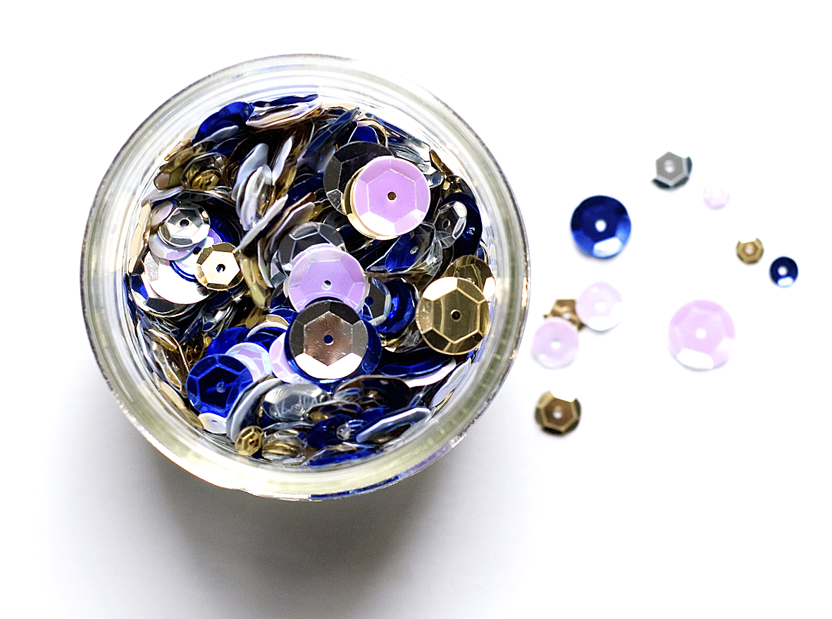
Deloitte refers to one or more of Deloitte Touche Tohmatsu Limited, a UK private company limited by guarantee (“DTTL”), its network of member firms, and their related entities. DTTL and each of its member firms are legally separate and independent entities. DTTL (also referred to as “Deloitte Global”) does not provide services to clients. Please see www.deloitte.com/about for a more detailed description of DTTL and its member firms.
This material has been prepared by Deloitte Touche Tohmatsu India LLP (“DTTILLP”), a member of Deloitte Touche Tohmatsu Limited, on a specific request from you and contains proprietary and confidential information. This material may contain information sourced from publicly available information or other third-party sources. DTTILLP does not independently verify any such sources and is not responsible for any loss whatsoever caused due to reliance placed on information sourced from such sources. The information contained in this material is intended solely for you. Any disclosure, copying or further distribution of this material or its contents is strictly prohibited.
Nothing in this material creates any contractual relationship between DTTILLP and you. Any mutually binding legal obligationsorrights may only be created between you and DTTILLP upon execution of a legally binding contract. By using this material and any information contained in it, the user accepts this entire notice and terms of use.
©2022 Deloitte Touche Tohmatsu India LLP. Member of Deloitte Touche Tohmatsu Limited
Deloitte Touche Tohmatsu India Private Limited (U74140MH199 5PTC093339), a private company limited by shares, was converted into Deloitte Touche Tohmatsu India LLP, a limited liability partnership (LLP Identification No. AAE-8458),with effect from October 1, 2015.

Slide 14
Competitive Bidding/Plug & Play Model/OPEX (2/2)
Financial Analysis
Input Values
Particulars | Unit | Values
Project Size | MW | 1,000
Competitive Tariff (PPA) | Rs. KWh | 2.94
CUF | % | 20
Degradation Factor | % | 0.50
Lease | Rs. Cr/MW | 0.03
Annual units Generated | MUs | 1,743
PSA rate from DISCOM’s | Rs. KWh | 3
Particulars | 1 | 2 | 3 | 4 | 5 | 6 | 7 | 8 | 9 | 10 | 11 | 12 | 13
Payables (Rs. Cr) | 513 | 513 | 513 | 513 | 513 | 513 | 513 | 513 | 513 | 513 | 513 | 513 | 513
Income from sale of power & Lease (Rs.Cr) | 553 | 553 | 553 | 553 | 553 | 553 | 553 | 553 | 553 | 553 | 553 | 553 | 553
Savings in PPC of JBVNL | 76 | 76 | 76 | 76 | 76 | 76 | 76 | 76 | 76 | 76 | 76 | 76 | 76
Net Profit/(Loss) | 117 | 117 | 117 | 117 | 117 | 117 | 117 | 117 | 117 | 117 | 117 | 117 | 117
Particulars | 14 | 15 | 16 | 17 | 18 | 19 | 20 | 21 | 22 | 23 | 24 | 25
Payables (Rs. Cr) | 513 | 513 | 513 | 513 | 513 | 513 | 513 | 513 | 513 | 513 | 513 | 513
Income from sale of power & Lease (Rs.Cr) | 553 | 553 | 553 | 553 | 553 | 553 | 553 | 553 | 553 | 553 | 553 | 553
Savings in PPC of JBVNL | 76 | 76 | 76 | 76 | 76 | 76 | 76 | 76 | 76 | 76 | 76 | 76
Net Profit/(Loss) | 117 | 117 | 117 | 117 | 117 | 117 | 117 | 117 | 117 | 117 | 117 | 117
Financials for Project Period of 25 Years
Particulars | Unit | Values
Total Expense | Rs. Cr | 12,813
Total Income | Rs. Cr | 15,733
Total Profit | Rs. Cr | 2,920

Slide 15
Key Insights: CAPEX Vs Competitive Bidding
Project Cost & Financials
Project Implementation
Installation of Solar Projects under CAPEX mode is beneficial as it enhances the profitability and revenue potential of the project as the revenue and profit sharing of the project lies within a single entity.
CAPEX attracts financial assistance from multilateral banks at nominal interest rates which in turn makes the project financially viable.
The return on equity, Internal rate of return in CAPEX projects are higher leading to shorter payback periods.
Project Implementation under CAPEX mode is comparatively easier and better managed as the ownership of the project lies with a single entity.
Quality of products, Technical standards of equipments, Feasibility analysis of the project is well taken care off under CAPEX projects as the responsibility of the entire project is under the ambit of a single umbrella .
Planning , execution of project plans and timely completion of project is better streamlined under CAPEX mode.
Collaboration
Risk Factor
CAPEX projects brings in an excellent opportunity to collaborate with multilateral agencies which enhances the quality and efficiency of the project due to the diverse experience of the agencies of working with various entities in different countries.
Also, multilateral financing agencies helps organizations to build in house capacities with various training programmes and also supports the organization with various improvements in systems and processes.
It is considered that under PPP, private sector efficiencies are expected to keep the tariffs low, however such low tariffs become financially unviable over the project period, thus increasing the risk.
The success of PPP depends upon the risk appetite of investors and the State, hence higher the perceived risk, higher will be the return requirement of private investor, thus impacting tariff.

Slide 16
Key Insights: Benefits of CAPEX over Competitive Bidding/ PPP
03
1
Enhanced profitability and revenue potential in CAPEX mode
Financial assistance from multilateral banks at nominal interest rates
Higher RoI and IRR leading to shorter payback periods
Financially Viable Project
03
2
Ownership of the project lies with a single entity
Better Quality and Technical standards of products and Feasibility analysis
Better streamlined planning, execution and timely completion of project
Better Project Implementation
03
3
Enhanced quality and efficiency of the project due to the experience of the agencies of working with diverse and international assignment.
Also, multilateral agencies helps build in-house capabilities and improvements in system and processes
Collaboration with multilateral agencies
03
4
Considering the risk appetite of investors and the State, higher the perceived risk, higher the return requirement of private investor, thus impacting tariff.
Private sector efficiencies are expected to keep the tariffs low, however low tariffs become financially unviable over the project period, thus increasing the risk.
Risk with PPP mode

Slide 17
State Solar Policy (2/3)
Jharkhand Solar Policy 2022 – Key Features
LAND
POWER PURCHASE
Suitable land/ dam/ canal parcels will be converted into a land/ dam/ canal bank for solar deployment under the provisions of Land Acquisition Act for a period of 30 years
There shall be 100% exemption of stamp duty and a 100% waiver on land use conversion charges/fees
Solar installations for EV charging on government land will also be eligible for an additional 50% concession on land lease payment.
Competitive bidding guidelines shall be followed for procurement of power from RE sources and the DISCOMs shall determine the appropriate ceiling tariff
Green tariff rate shall be either lower than or equivalent to the average pooled power purchase cost of non-conventional sources of energy of DISCOM to encourage early movers
SLDC may ensure ‘Must Run’ Status of Solar Plants in the State
INCENTIVES
OPEN ACCESS
Electricity duty and SGST shall be exempted/reimbursed for 5 years from COD
All costs of building/ augmenting necessary grid infrastructure for connectivity shall be borne by the State Government
The state subsidy shall be available over and above the central subsidy.
If project is completed and commissioned within the scheduled period, then exemption on electricity duty and banking charges for 10 years
For intra-state Open Access, Grid-connected solar power projects with storage systems selling power shall attract 100% exemption from transmission and wheeling charges for a period of 10 years
Cross-subsidy surcharge and additional surcharge shall be exempted solar power projects set up for third party sale within the state (less than 25 MW) and captive solar projects
Banking of 100% of energy shall be permitted during all 12 months of the year

Slide 18
Key Insights: Benefits of CAPEX over Competitive Bidding/ PPP (1/4)
Evaluation Matrix
Particulars | Competitive Bidding: Model 1 | Competitive Bidding: Model 2 | CAPEX
Up-front Equity Infusion by GoJ
Liability on GOJ
Profitability
Savings in PPC of JBVNL
Fulfillment of RPO Obligation
Financially Viable Competitive Tariff
Risk of Project Completion/Stranded PPA
Capacity Building & Other Benefits
Manufacturing & Employment generation
Yes
Maybe
No

